Slide 1
FIR Filter Design using Distributed Arithmetic of Lookup Table
A project by
Subhadeep [20BEC1059]
Mayank [20BEC1060]
Sai Advaith [20BEC1069]
Notes:
When listing all project collaborators, either use commas or bullets

Slide 2
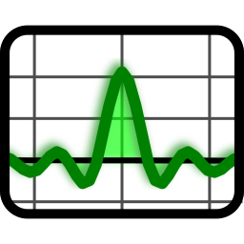
Introduction …
Filters are essential components in digital signal processing (DSP) used to eliminate some undesirable elements or features from a signal.
Types of Filters:
Low-pass filter (LPF)
High-pass filter (HPF)
Band-pass filter (BPF)
Band-stop filter (BSF)
Notes:
Insert a map of your colony (draw it, ink it, or create it in PPT- be creative!)
Insert -> Pictures for photos
Draw for digital inking
Insert -> Shapes if you want to create it in PPT
All mountains, towns/villages, bodies of water/waterways, landmarks, etc. should be clearly labeled

Slide 3
Digital Filter Types ….
There are several types of digital filters commonly used in digital signal processing (DSP).
Main types:
Finite Impulse Response (FIR) Filter
Infinite Impulse Response (IIR) Filter

Slide 4
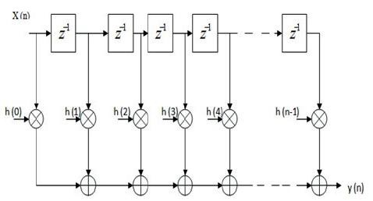
FIR Filter …
FIR filters have a finite duration response.
FIR filters have a stable impulse response that eventually reaches zero.
It has linear phase characteristics and can provide precise control over the filter response.
Applications…
Design Technique…
Noise suppression, Imaging devices (medical, etc.)
Enhancement of selected frequency ranges, Equalizers for audio systems (increasing the bass)
Removal or attenuation of selected frequencies, Removing interferences at a specific frequency
Bandwidth limiting, anti-aliasing filters for sampling
Windowing Method (Hamming, Hanning, and Blackman)
Frequency Sampling Method
Least Squares Method
Parks-McClellan Algorithm (Remez Algorithm)
Distributed Arithmetic
Notes:
Think about the questions listed above and answer them.
Can you think of anything else in regards to economy and trade that you would like to add?

Slide 5

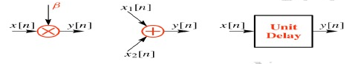
Problem Identified …
The problem identified in FIR Filter design is the use of conventional design techniques which impacts its performance in terms of delay, power consumption and area.
The implementation requires 3 basic building blocks: (a)Multiplier (b) Adder (c) Signal delay.
Usage of these blocks increases the hardware area, cost, Computational time thereby increasing the latency.
Notes:
Use the SmartArt to determine the flow of government/leadership:
Who leads the colony (executive)? What is that person/are those people’s duties?
Who makes the rules (legislature)?
Who ensures the rules are followed (judicial)?
Are there any other branches of government? If so, who are they and what is their job?
To add more shapes, click on the left shape first, then on SmartArt Tools -> Design -> Add Shape After
Do the same for the shape to the right
Feel free to rename the branches!

Slide 6
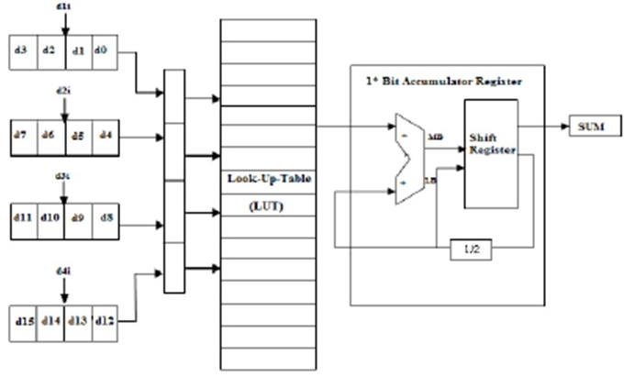
Distributed Arithmetic …
Distributed Arithmetic (DA) is a technique for implementing sum-of-products computations without the use of multipliers.
Designers frequently use DA to build efficient Multiply-Accumulate Circuitry (MAC) for filters and other DSP applications.
Advantage of DA
High computational efficiency.
DA distributes multiply and accumulate operations across shifters, lookup tables (LUTs), and adders in such a way that conventional multipliers are not required.
Notes:
What are the rules and laws of your colony? Think about what helps the colonists stay safe and maintain a healthy, happy colony.
In each shape…
Name the rule/law
Describe why it’s important for the colony/colonists
Explain the consequences for not following this rule/law
To add more shapes, click on the last shape, then on SmartArt Tools -> Design -> Add Shape After

Slide 7

Objectives …
Study of different techniques to design FIR Filter.
Analyzing the effect of Introducing Distributed arithmetic Lookup Tables (LUTs) in place of multipliers.
To achieve Optimization in terms power and delay for an FIR filter.
Comparing the power and delay of the designed fir filter with the pre-existing work.
Notes:
Think about the questions/situations listed above and answer them.
Can you think of anything else in regards to transportation that you would like to add?

Slide 8
Literature Survey …
Design Techniques | Problems Identified
Windowing Method (Hamming, Hanning, Blackman) | Complexity and low computational efficiency
Frequency Sampling Method | Inaccurate control over desired frequency response
Least Squares Method | High error between desired and actual frequency response
Parks-McClellan Algorithm (Remez Algorithm) | Cannot design filters with very specific frequency response specifications
“Constrained Least Square Design of FIR Filters without Specified Transition Bands.”
“Efficient and Accurate Optimal Linear Phase FIR Filter Design Using Opposition-Based Harmony Search Algorithm.”
“Implementation of Fir Filter Using VLSI.”
“Design of Arbitrary Complex Coefficient FIR Digital Filters by Complex Weighted Least Squares Approximation”

Slide 9
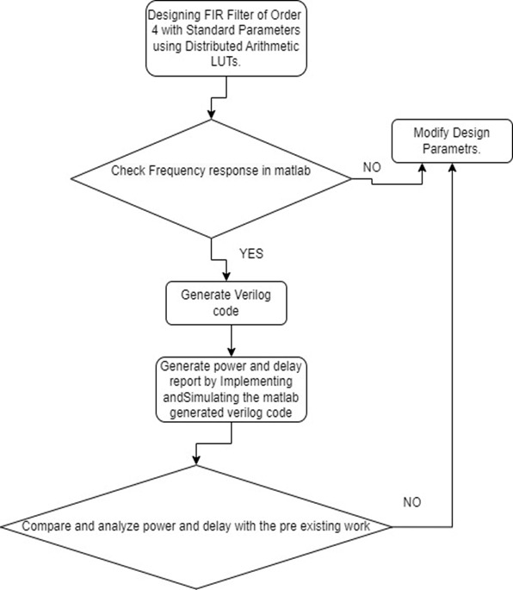

Methodology …
Studying the different techniques of Designing FIR Filter.
Generating the Verilog code from implemented FIR Filter using MATLAB.
Testing and implementing the generated Verilog code in Xilinx software and Generating the Power and Delay Report.
Comparing the power and delay of the designed fir filter with the pre-existing work
Notes:
What is the name of your colony song?
Write lyrics to the song and, if you are feeling creative, use a computer program or instruments to create the music that goes along with it!
To insert an audio file, click on Recording -> Audio -> Audio on My PC and choose your file

Slide 10

Result & Discussion …
Notes:
Have fun with this slide! Use drawing paper or inking to create your colony’s flag, flower, bird, tree, and its most famous person!
If you use drawing paper, take a photo and insert the image
If you choose to use digital inking, click on the Draw tab and ink away!

Slide 11
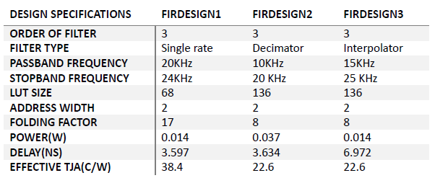
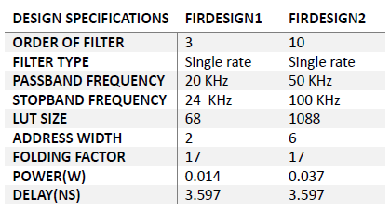
Result & Discussion …

Slide 12


Conclusion & Future Work …
Finite impulse response (FIR) filters find extensive use in digital signal processing. The Distributed Arithmetic approach with Look Up Table (LUT) is employed to create multiplier-less FIR filters, reducing latency, area, and power consumption. Memory access is faster than multiplication, and LUT split reduces memory requirement
Implementing the design at the Circuit Level in Cadence software and comparing results with Xilinx gate-level RTL Schematic and other filter design techniques.
Hybrid design algorithms combining optimization approaches like PSO, GA, and CSO may be explored for better outcomes.
Further improvement can be achieved through pipeline implementation

Slide 13
Outcome
A research paper titled "FIR Filter Design Using Distributed Arithmetic with Lookup Tables (LUTs)" has been submitted to the International Conference on Data Science and Applications (ICDSA 2023) at MNIT Jaipur. It is currently under review for acceptance and, if approved, will be published in the SCOPUS indexed Springer Book Series "Lecture Notes in Networks and Systems”.
Track Name: ICDSA2023
Paper ID: 866

Slide 14
Sustainable Development Goal
Decent Work and Economic Growth
Industry, Innovation, and Infrastructure
Responsible Consumption and Production
Partnerships for the Goals

Slide 15
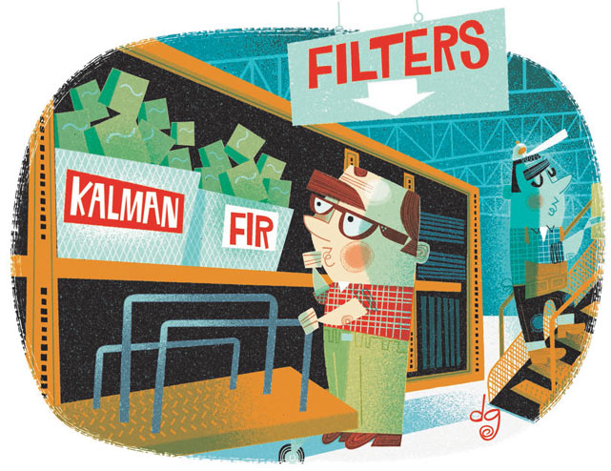
Thank You …

